Slide 1
Chapter 9 – Classification and Regression Trees
Data Mining for Business Analytics
Concepts, Techniques and Applications with JMP Pro
Shmueli, Bruce, Stephens & Patel
© Galit Shmueli, Peter Bruce and Mia Stephens 2016

Slide 2
Decision Trees and Rules
Goal: Classify or predict an outcome based on a set of predictors
The output is a set of rules represented by tree diagrams
Example Rules:
Goal: classify a record as “will accept credit card offer” or “will not accept”
Rule might be “IF (Income >= 99) AND (Education = 1) AND (Family < 3) THEN Prob(Class = 1) = 0.0077 (classify as non-acceptor)

Slide 3
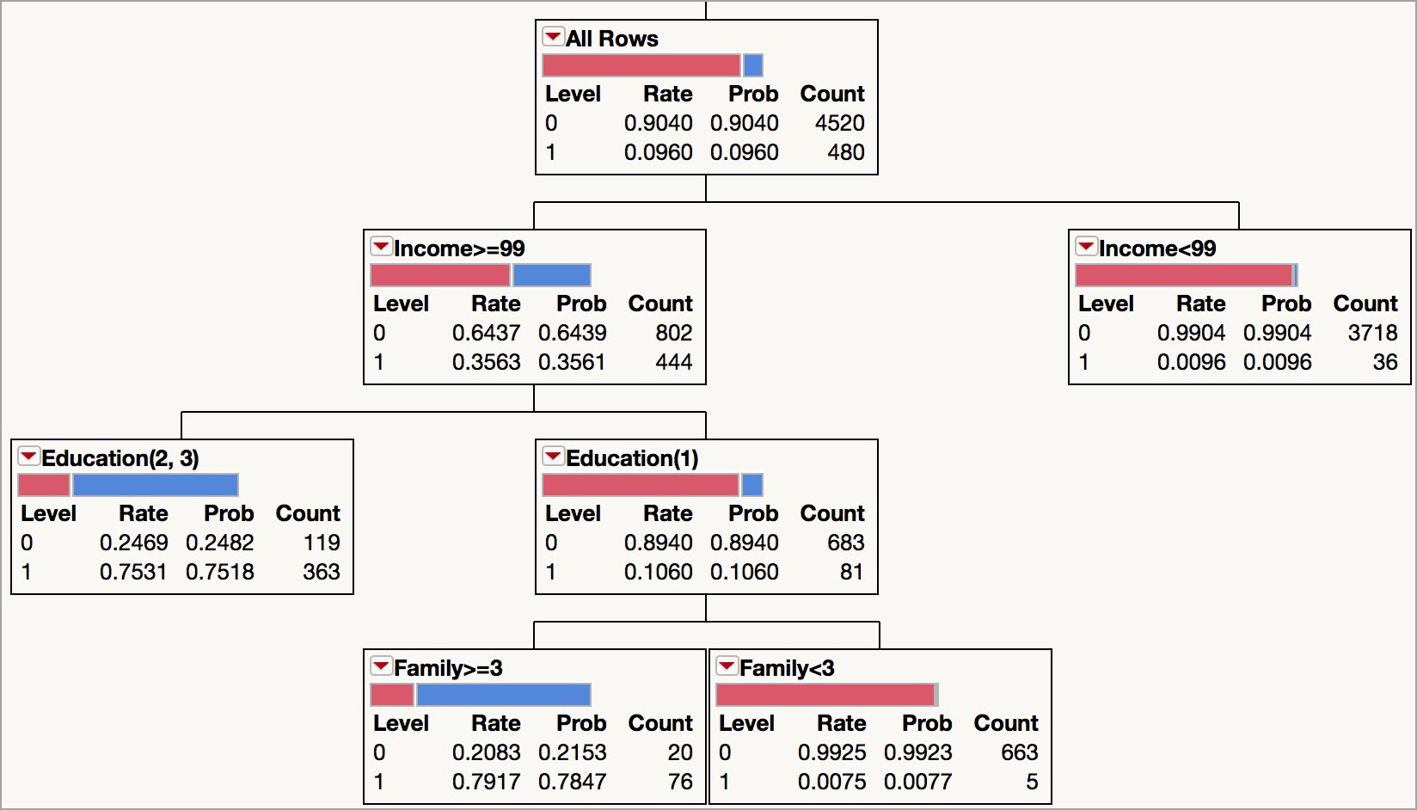
Example Tree

Slide 4
Key Ideas
Recursive partitioning: Repeatedly split the records into two subsets so as to achieve maximum homogeneity within the new subsets (or, equivalently, with the greatest dissimilarity between the subsets)
Pruning the tree: Simplify the tree by pruning peripheral branches to avoid overfitting

Slide 5
Recursive Partitioning
(In Classification Trees)

Slide 6
Recursive Partitioning Idea
Pick one of the predictor variables, x_{i}
Pick a value of x_{i,} say s_{i}, that divides the training data into two (not necessarily equal) portions
Measure how dissimilar each of the resulting portions are
Try different values of x_{i,} and s_{i} to maximize the dissimilarity in the initial split
After the first split, repeat the process for a second split, and so on
Notes:
Note that measures of impurity (Gini and Entropy) are used in other software packages to determine split variables and split values. These measures are discussed later.

Slide 7
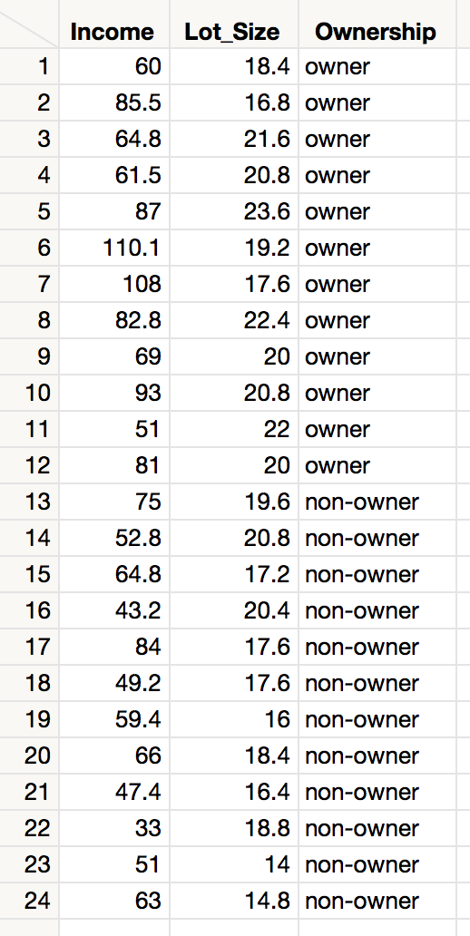
Example: Riding Mowers
Goal: Classify 24 households as owning or not owning riding mowers
Predictors: Income, Lot Size

Slide 8
Splitting on Categorical Variables
Examine all possible ways in which the categories can be split.
E.g., categories A, B, C can be split 3 ways
  {A} and {B, C}
  {B} and {A, C}
  {C} and {A, B}
With many categories, # of potential splits becomes huge

Slide 9
Splitting on Categorical Variables
For ordinal data (ordered categories) there is an option for the splits to respect ordering
Example: An ordinal predictor takes on the values 1, 2, 3, or 4
The data can be split 3 ways:
  {1} and {2, 3, 4}
  {1, 2} and {3, 4}
  {1, 2, 3} and {4}

Slide 10
Splitting on Continuous Variables
Order records according to one variable, say lot size
Split at the first value
Measure the dissimilarity between the two subsets
Split at the next value, and continue
Repeat for the other variable(s)
For all variables, the split value that drives the greatest dissimilarity in propensities (or probabilities) is selected as the split point

Slide 11
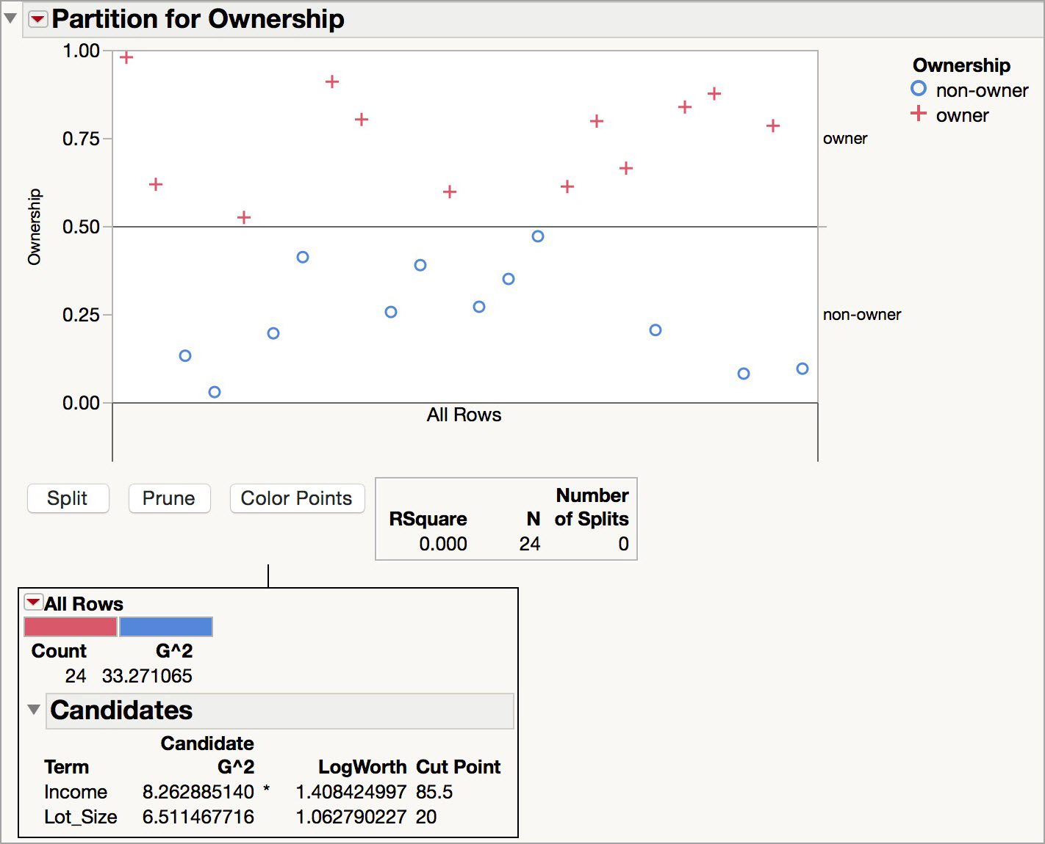
Illustration: the Riding Mower Data
Before splitting (50% are owners and 50% are non-owners)
All splits are considered (see Candidates)
The first split variable is Income, and the cut point is 85.5

Slide 12
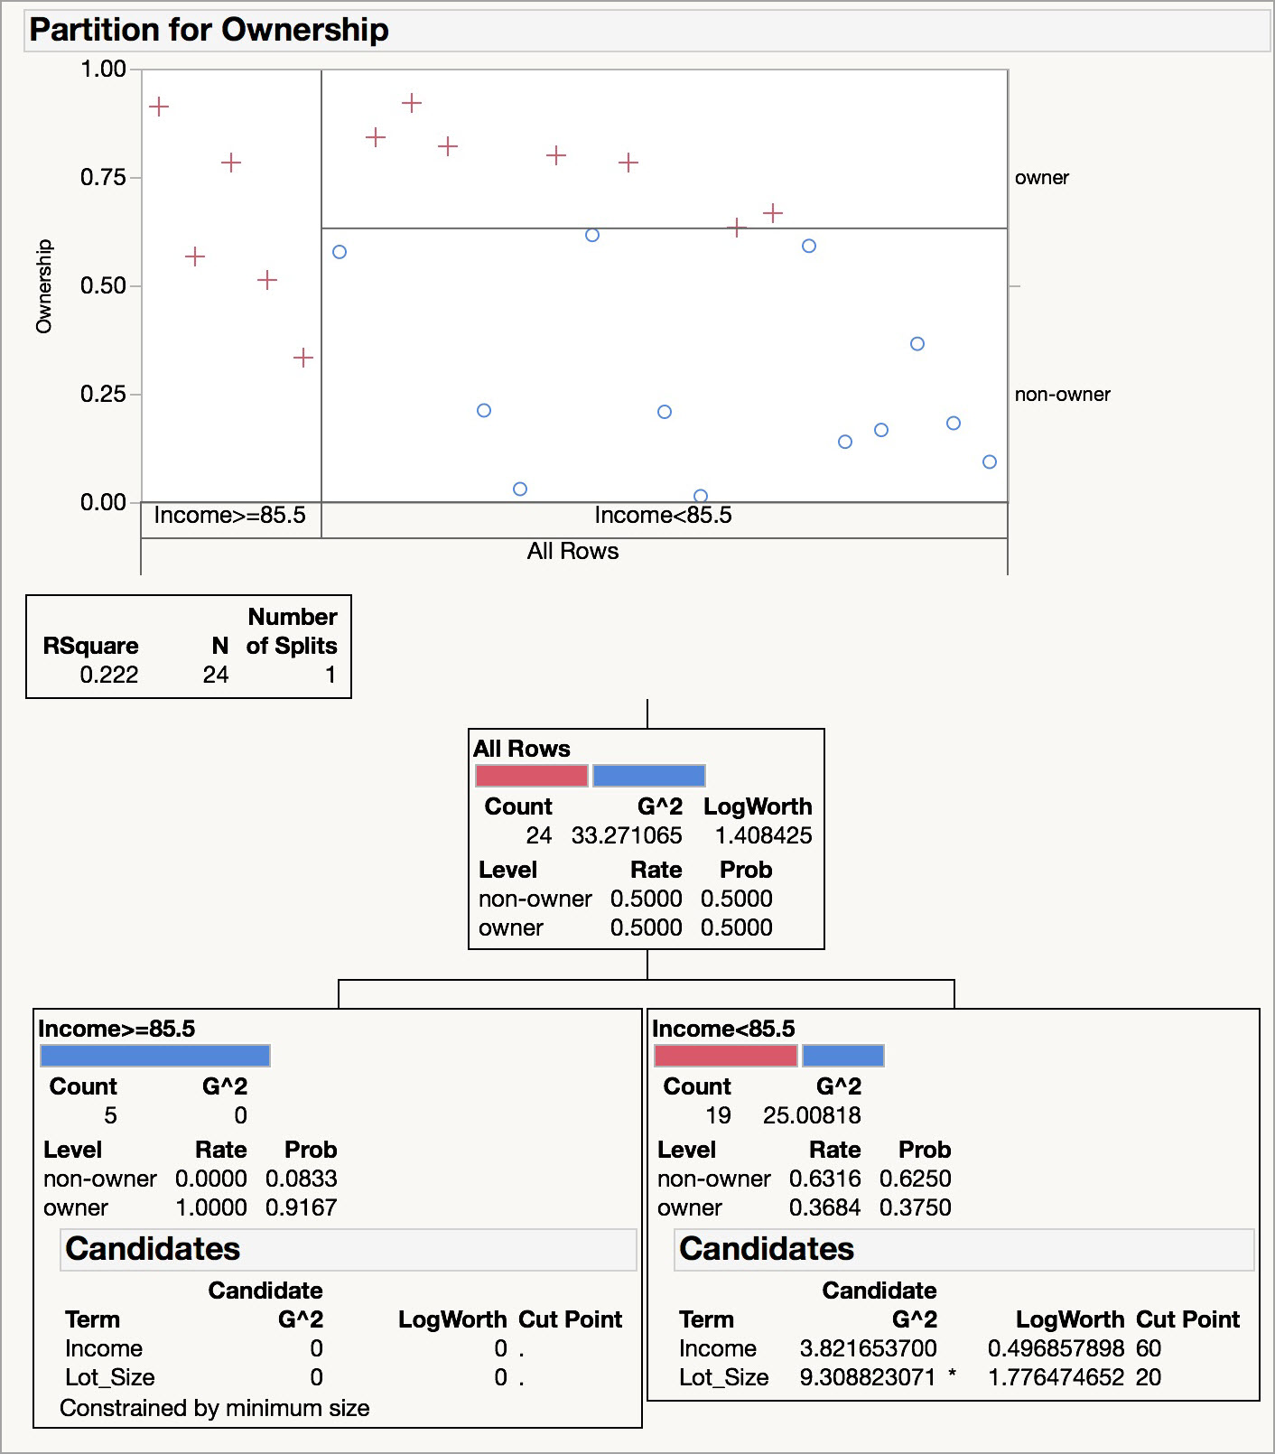
Illustration: the Riding Mower Data
When Income >= 85.5, all of the households were Owners (this “node” is “pure”).
The next split is Lot Size when Income < 85.5.
The cut point is 20.
Notes:
Analyze > Modeling > Partition. Or, in JMP 13, Analyze > Predictive Modeling > Partition. Under the top red triangle, select Display Options > Show Split Prob

Slide 13
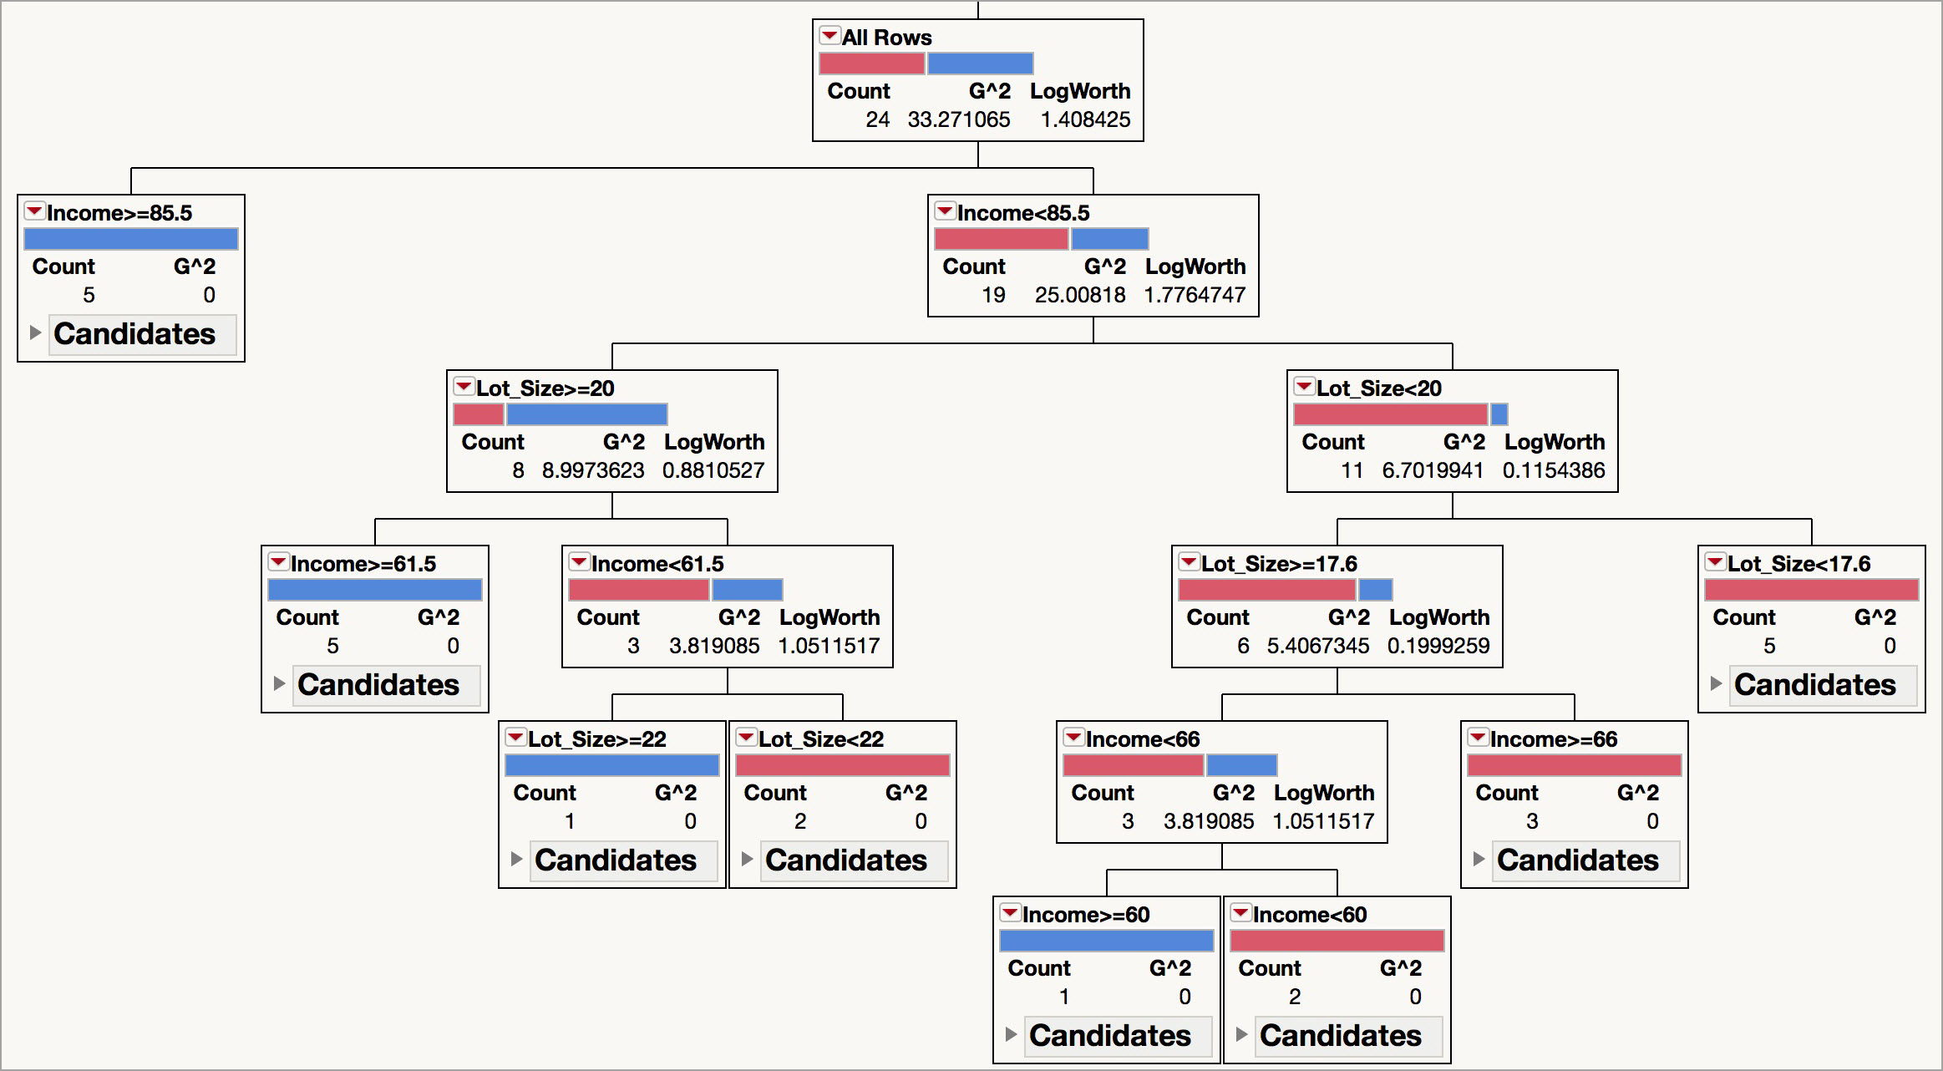
Illustration: the Riding Mower Data
The final tree after 7 splits (probabilities are hidden)
Notes:
Some display options were changed in this output (under the top red triangle)

Slide 14
Tree Structure
Split points become nodes on the tree
Leaves are the terminal nodes (there are no further splits)
Read down tree to derive the decision rule
    E.g., Income < 85.5, Lot Size is >= 20, and Income >=61.5 , the probability that a household is an owner is 0.9185.
Records within each node are from the training data (validation data are not used in building the tree)
Default cutoff = 0.5 is used for classification
    In the previous example, the record would be classified as an owner.
Notes:
Probabilities were turned off in the previous screen shot to save space – these values can be seen in the leaf report on the next slide. Save the probability formula to the data table to see the classifications for each record.

Slide 15
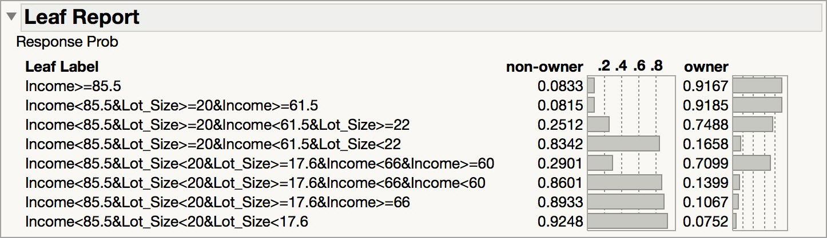
Illustration: the Riding Mower Data
The leaf report provides a summary the splits
It displays the rules for classifying outcomes
For example, If Income < 85.5, Lot Size is < 17.6, the probability that a household is an owner is 0.0752. This record will be classified as a non-owner.
Notes:
This is an option under the red triangle

Slide 16
The Overfitting Problem

Slide 17
Stopping Tree Growth
Natural end of process is 100% purity in each leaf
This overfits the data, which end up fitting noise in the data
Overfitting leads to low predictive accuracy of new data
Past a certain point, the error rate for the validation data starts to increase

Slide 18
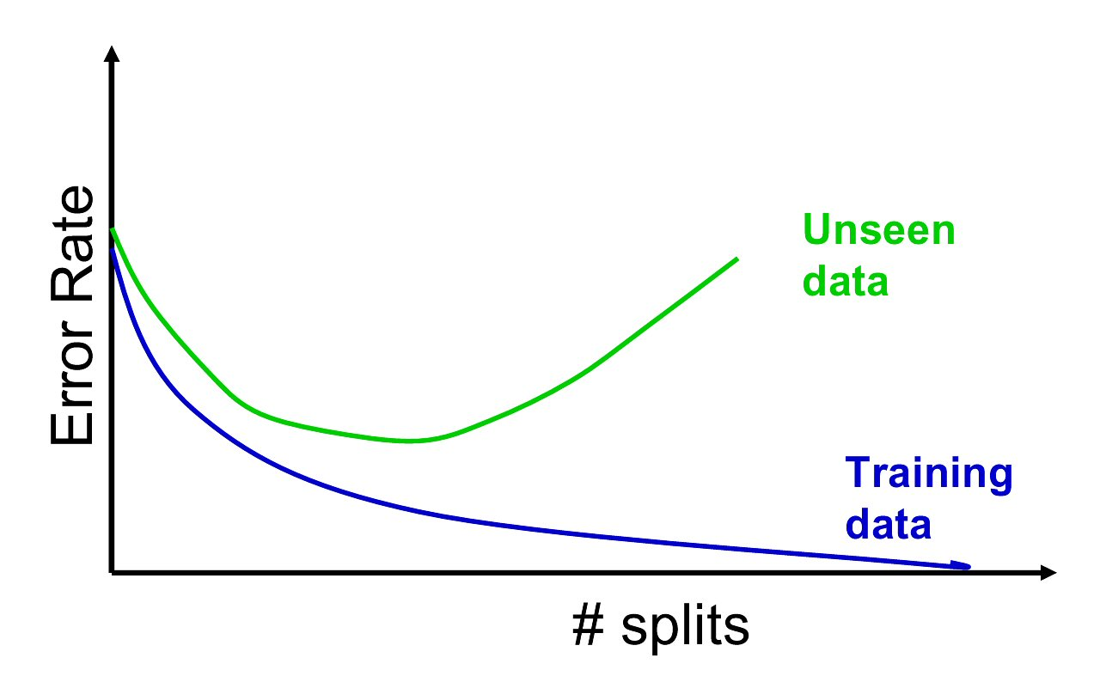
Full Tree Error Rate

Slide 19
CHAID
CHAID, older than CART, uses chi-square statistical test to limit tree growth
Splitting stops when purity improvement is not statistically significant

Slide 20
CART
CART lets tree grow to full extent, then prunes it back
Idea is to find that point at which the validation error begins to rise
Generate successively smaller trees by pruning leaves
At each pruning stage, multiple trees are possible
Use cost complexity to choose the best tree at that stage

Slide 21
Cost Complexity
CC(T) = Err(T) + α L(T)
CC(T) = cost complexity of a tree
Err(T) = proportion of misclassified records
α = penalty factor attached to tree size (set by user)
Among trees of given size, choose the one with lowest CC
Do this for each size of tree

Slide 22
How JMP Limits Tree Size
JMP uses a combination of limiting tree growth and pruning the tree after it has grown
Minimum Split Size: Controls the minimum number of records in terminal nodes
Validation: The tree is grown, and pruned back to maximize the RSquare on the validation data
When validation is used, the “Go” option automates tree growth and pruning

Slide 23
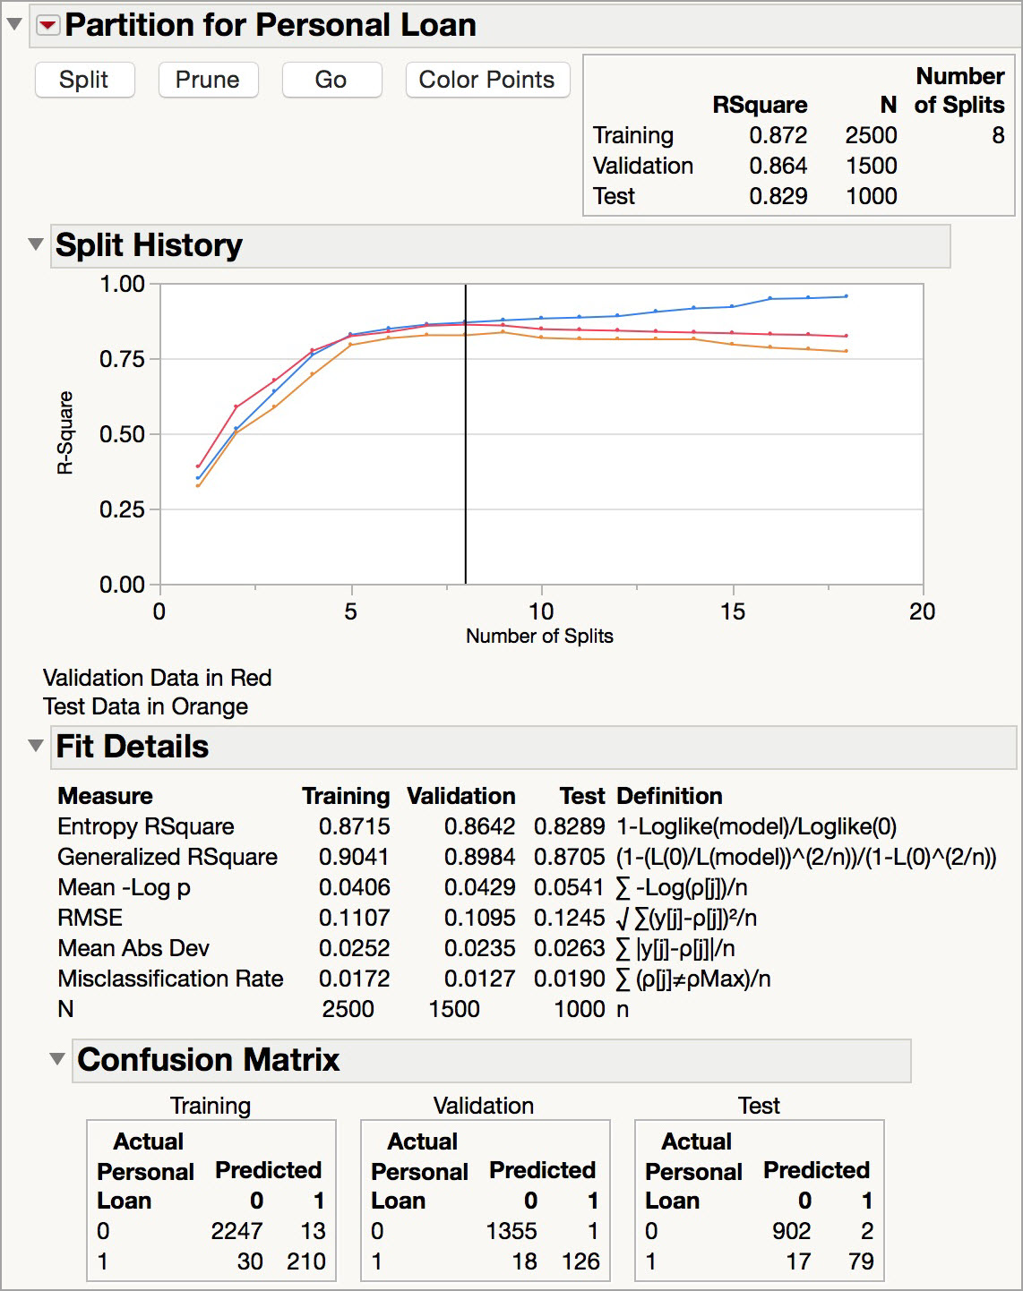
The tree with the maximum Validation Rsquare has 8 splits
The tree is grown to 18 splits, and is pruned back to 8 splits
Validation error rate and confusion matrix for the final tree (cutoff for classification = 0.50)

Slide 24
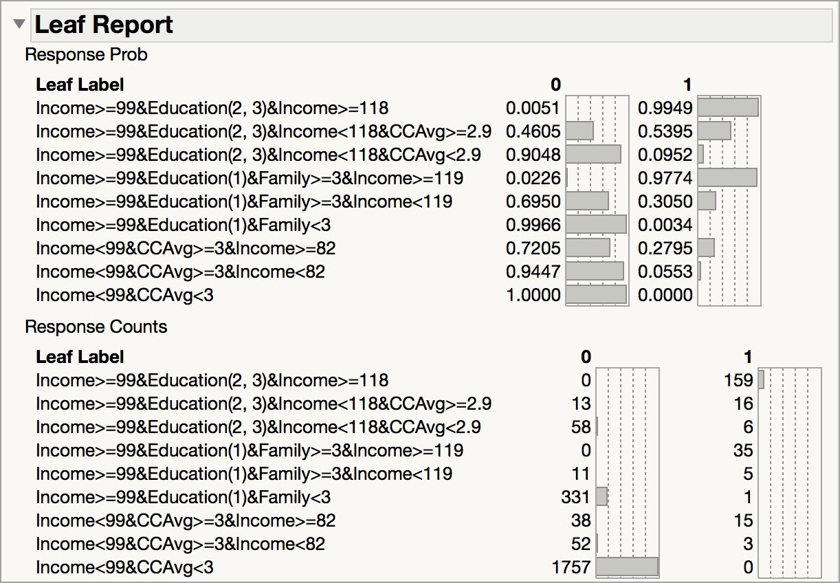
Leaf Report – Final Tree

Slide 25
Measuring Impurity

Slide 26
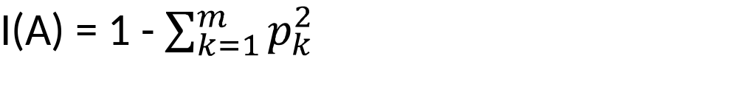
Gini Index
Gini Index for rectangle A containing m records
p = proportion of cases in rectangle A that belong to class k
  I(A) = 0 when all cases belong to same class
  Max value when all classes are equally represented (= 0.50 in binary case)

Slide 27
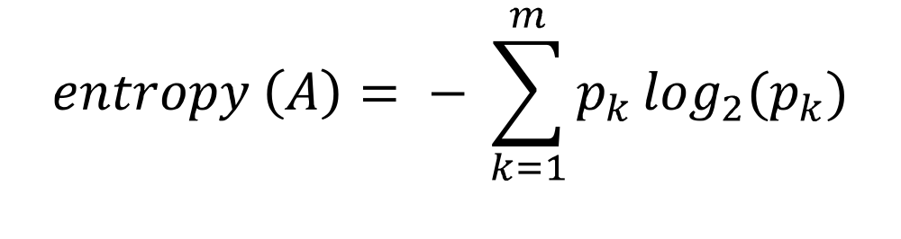
Entropy
p = proportion of cases (out of m) in rectangle A that belong to class k
Entropy ranges between 0 (most pure) and log₂(m) (equal representation of classes)

Slide 28
Impurity and Recursive Partitioning
Obtain overall impurity measure (weighted avg. of individual rectangles)
At each successive stage, compare this measure across all possible splits in all variables
Choose the split that reduces impurity the most
Chosen split points become nodes on the tree
Note that Gini and Entropy measures are not available in JMP. JMP uses measures of dissimilarity (G² and Sum of Squares) rather than measures of impurity.

Slide 29
Regression Trees

Slide 30
Regression Trees for Prediction
Used with continuous outcome variable
Procedure similar to classification tree
Many splits attempted, choose the one that maximizes the difference between subgroup means
Difference measured as the sum of squared deviations
Prediction is the average of the numerical target variable (rather than a probability)

Slide 31
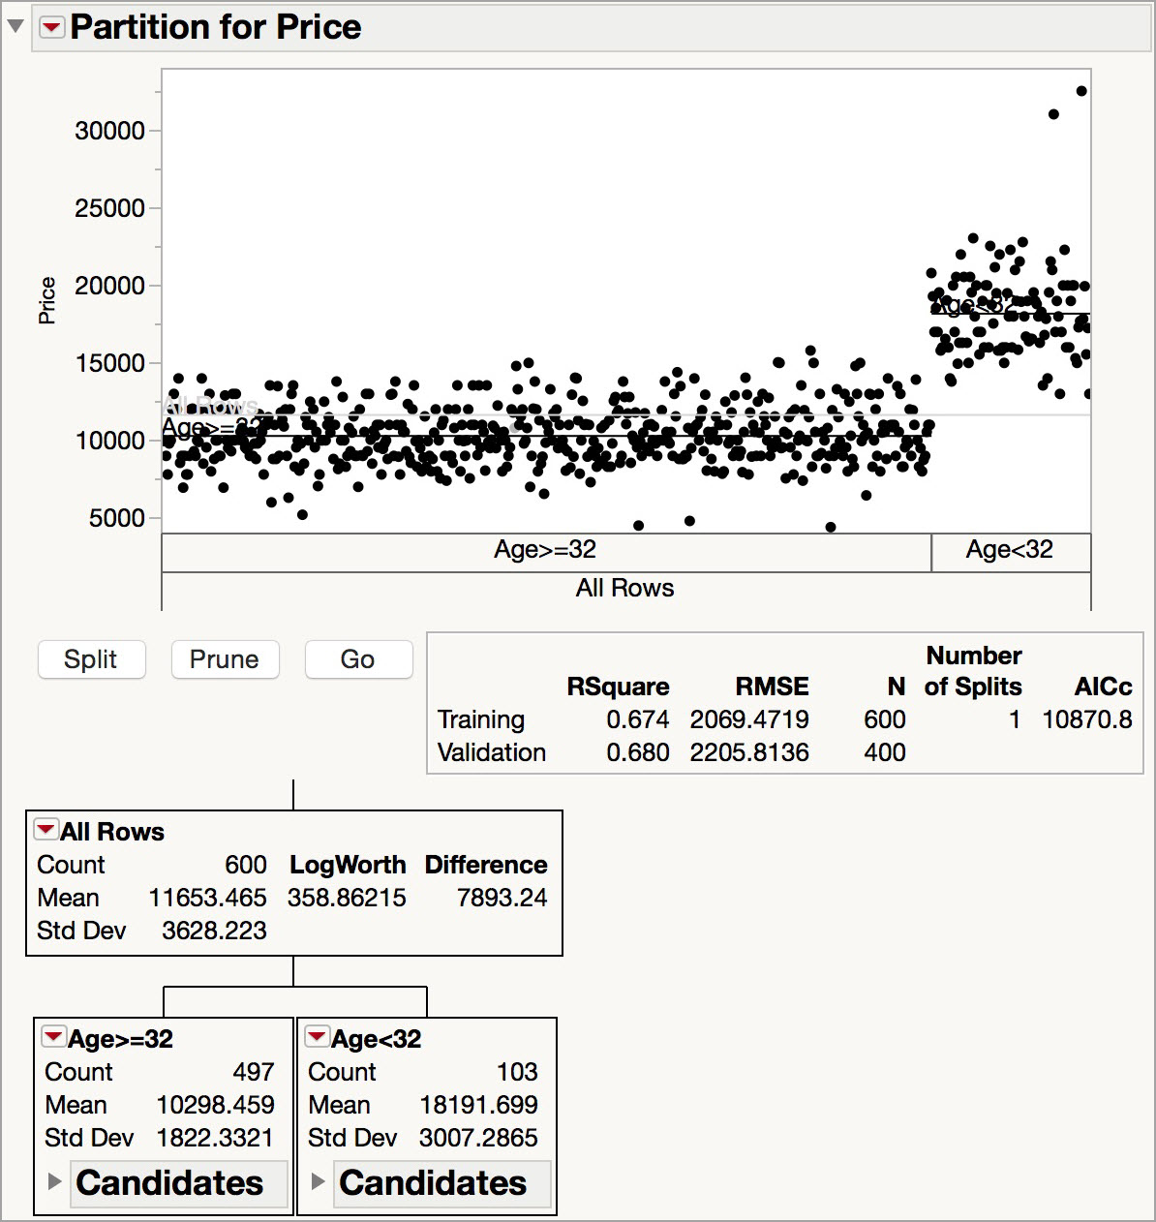
Example: Toyota Corolla Prices
The target variable is Price.
The model predicts the mean price.
The first split is on Age, at a cut point of 32 years.

Slide 32
Advantages of trees
Easy to use, understand
Produce rules that are easy to interpret & implement
Variable selection & reduction is automatic
Do not require the assumptions of statistical models
Can work without extensive handling of missing data (this is an option in the Partition dialog in JMP)

Slide 33
Disadvantages
May not perform well where there is structure in the data that is not well captured by horizontal or vertical splits
Since the process deals with one variable at a time, no way to capture interactions between variables

Slide 34
Improving Trees
Single trees may not have good predictive ability.
Results from multiple trees can be combined to improve performance
The resulting model is an “ensemble” model
Two multi-tree approaches in JMP Pro:
  Bootstrap Forests (a variant of Random Forests)
  Boosted Trees

Slide 35
Ensemble Tree Methods
Bootstrap Forests
  A random sample is drawn with replacement from the data set(bootstrapping)
  Predictors are randomly drawn from the candidate list of predictors
  A small tree is fit (a “weak learner”
  The process is repeated
  The final model is the average of all of the trees, producing a “Bootstrap aggregated” (or “bagged) model

Slide 36
Ensemble Tree Methods
Boosted Trees
  A simple (small) tree is fit to the data with a random sample of the predictors
  The scaled residuals from this tree are calculated
  A new simple tree is fit to these scaled residuals with another random sample of predictors
  This process continues
  The final boosted model is the sum of the models for the individual trees
Notes:
In JMP 13 there is an option to also randomly sample with replacement from the data (stochastic gradient boosting)

Slide 37
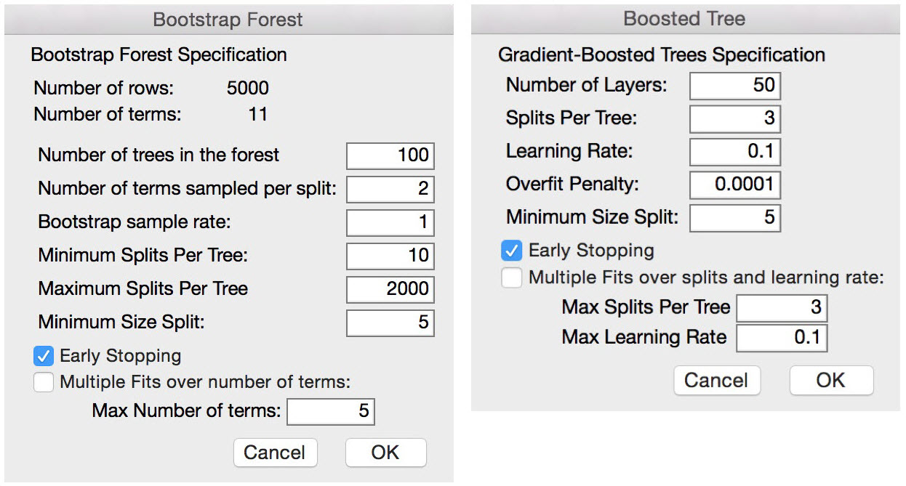
Ensemble Tree Methods - Options

Slide 38
Summary
Classification and Regression Trees are an easily understandable and transparent method for predicting or classifying new records
A tree is a graphical representation of a set of rules
Trees must be pruned to avoid over-fitting of the training data
As trees do not make any assumptions about the data structure, they usually require large samples

